Slide 1
Midterm Report
Drew Massey
Dale Bromenshenkel
Brad Hoffman

Slide 2
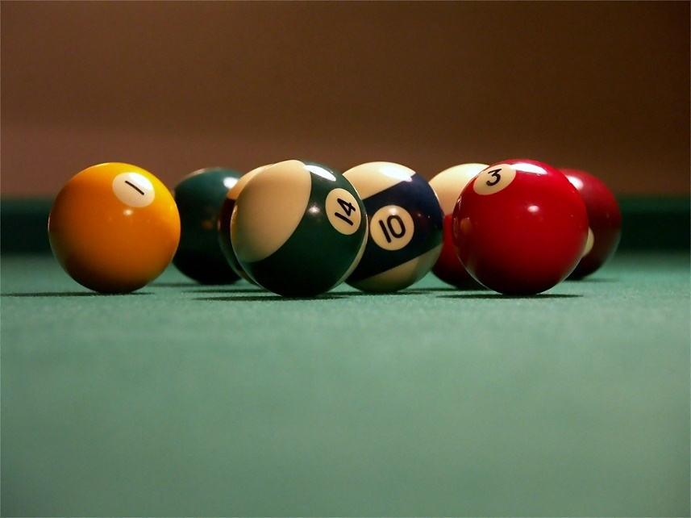
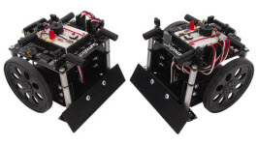
Main Objective
Create a system which can take in camera input, process the image, and use the data to drive a robot.

Slide 3

Current Setup
Github Code Repository
Prototype area
Little Robot
SimpleCV Python Modules

Slide 4

SImpleCV
Simple Computer Vision
Python Module
Dependencies: OpenCV, Pygame, Scipy, Numpy, SvgWrite
Ball Track
Tracks a ball around the screen

Slide 5
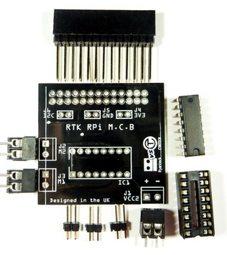
Robot
Description
The robot will run off a Raspberry Pi 2 and a Ryanteck motor driver
The motors and Pi will be powered by an external USB battery pack
Completed
Code for keyboard controlled motion (waiting for the Ryanteck board to fully test)
Circuit for testing the Pi’s GPIO pins
Sketch of tentative robot design

Slide 6


Future Tasks
Integrate code into Jenkins
Allow continuous integration of code
Scale up design area
Build a bigger testing area
Give robot more abilities
Interact more with environment
Integrate SimpleCV into Blender for realtime 3D data.

